Slide 1
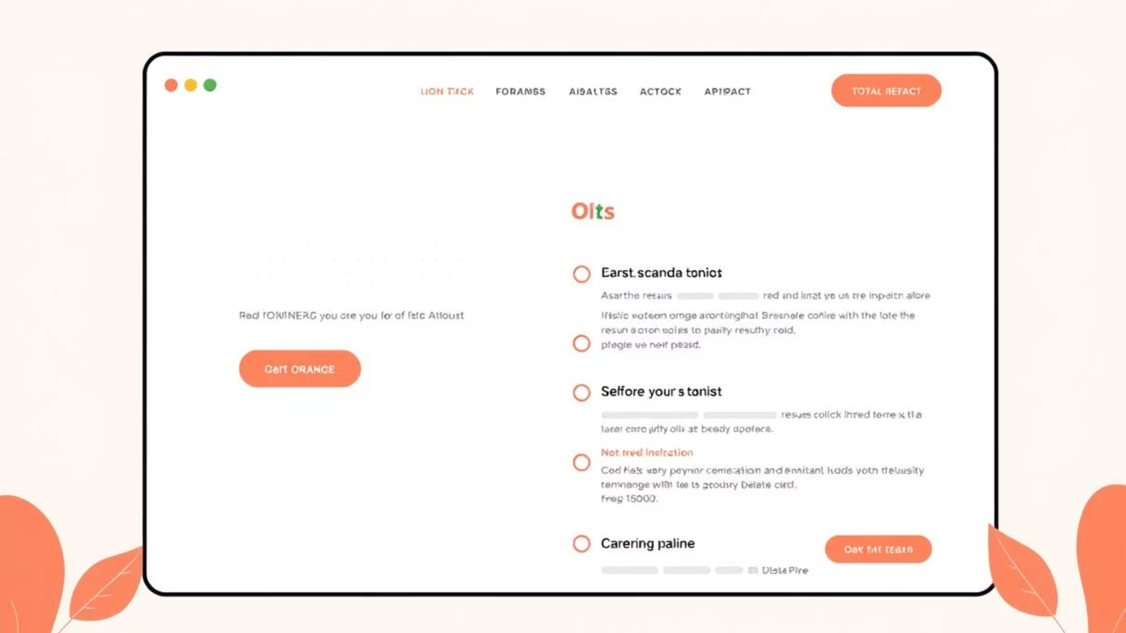
MERN Stack Resume Builder
The MERN Stack Resume Builder is a sophisticated web application designed to streamline and enhance the resume creation process. It goes beyond traditional builders by offering a dynamic and interactive experience, integrating live previews, real-time ATS (Applicant Tracking System) scoring, and intuitive analytics to help users craft optimized, job-winning resumes.

Slide 2



Revolutionizing Resume Creation
In today's competitive job market, a compelling resume is crucial. Our MERN Stack Resume Builder empowers users with tools that not only simplify the creation process but also provide critical insights into resume effectiveness.
Live Preview & Editing
Real-time ATS Scoring
Personalized Dashboard
Experience real-time updates as you type, ensuring your resume looks perfect before you save.
Get instant feedback on your resume's compatibility with Applicant Tracking Systems, helping you optimize for success.
Manage and track multiple versions of your resume with ease, all from a centralized user dashboard.

Slide 3
Key Features at a Glance
The MERN Stack Resume Builder is packed with features designed to provide a comprehensive and efficient experience from start to finish.
Seamless User Experience
Robust Management & Analytics
Intuitive Home Page with clear navigation.
Personalized User Dashboard for managing saved resumes.
Detailed About & Contact Pages for support and information.
In-depth analytics for saved resumes, including domain-wise scores.
Dynamic Resume Building
Professional PDF/Word export for easy sharing.
Live typing interface with instant preview updates.
Secure & Modern Authentication
Real-time ATS scoring and visual graphs for immediate feedback.
Flexible sign-up/login options: Google, GitHub, or manual.
Interactive domain and skill analysis with live graphs.
Utilizes OAuth and JWT for secure access.

Slide 4
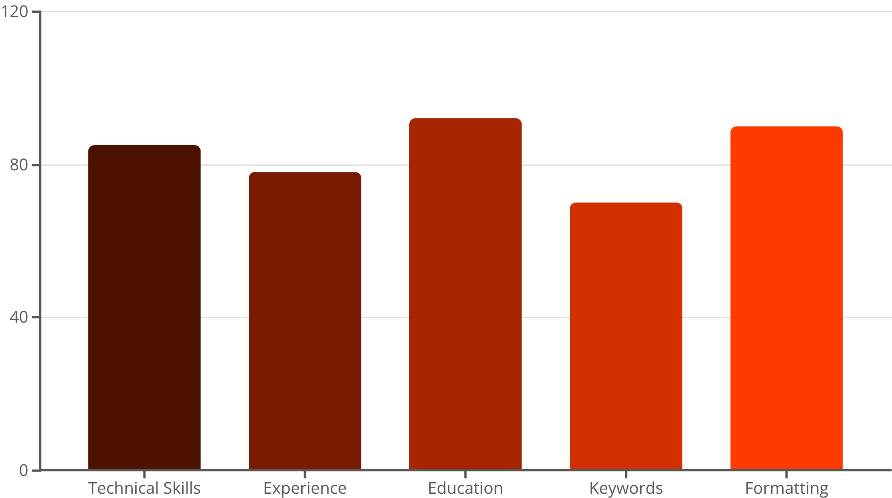

ATS Scoring and Domain Analysis
Our innovative ATS scoring mechanism and domain analysis tools provide unparalleled insights, helping users fine-tune their resumes for optimal performance against automated screening systems.
The bar chart above illustrates a sample ATS score breakdown by domain. Users receive a score for various sections like "Technical Skills," "Experience," and "Education," alongside specific feedback on areas for improvement. This data empowers them to make targeted adjustments, significantly increasing their chances of passing initial ATS screenings.
Beyond overall scores, the platform tracks strong and weak domains, providing interactive graphs that allow users to visualize their resume's strengths and weaknesses at a glance.

Slide 5





Under the Hood: Our Robust Tech Stack
Built on the robust MERN stack, our resume builder leverages modern web technologies to deliver a fast, responsive, and secure application.
Frontend
React: Dynamic and interactive user interfaces. Tailwind CSS / Custom CSS: Clean, responsive design. Chart.js / Recharts: Powerful data visualization.
1
Backend
2
Node.js: Server-side execution environment. Express: Fast, unopinionated web framework.
3
Database
MongoDB Atlas: Scalable NoSQL cloud database.
Authentication
4
OAuth (Google, GitHub): Secure third-party logins. JWT: Token-based authentication.
Key Libraries & Tools: axios (HTTP requests), jsPDF (PDF generation), pdf-parse, pdfplumber, docx (Word document handling), FPDF.

Slide 6
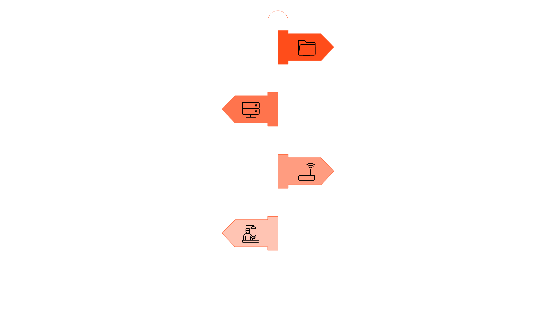




Project Architecture
The application follows a clear, modular structure, ensuring maintainability, scalability, and efficient development.
resume-builder
Root folder for the MERN application.
backend
API server with routes and logic.
routes
Defines API endpoints for auth and resumes.
controllers
Business logic handling requests.
backend/
routes/ # API routes (auth, resumes, scoring)
controllers/ # Business logic
models/ # MongoDB schemas
app.js # Express server
frontend/
src/
components/ # Reusable UI components
pages/ # Home, About, Contact, Dashboard, Resume Creator
services/ # API service calls
App.js

Slide 7

Using the Application
The MERN Stack Resume Builder is designed for intuitive use, allowing users to effortlessly navigate from account creation to resume export.
Access the App
Open the application in your web browser.
Authenticate
Sign up or log in using your Google, GitHub account, or a manual registration form.
Create Your Resume
Navigate to the "Create Resume" section and begin typing your details.
Optimize & Refine
Observe the live preview as you type and utilize real-time ATS scoring and visual graphs to optimize your resume.
Save & Download
Save your resume to your dashboard for future edits and download it as a PDF or Word document.

Slide 8
API Endpoints
Our RESTful API provides comprehensive endpoints for user authentication, resume management, and ATS scoring, forming the backbone of the application's functionality.
Authentication
POST /api/auth/login – User login
POST /api/auth/signup – User registration
Resume Management
GET /api/resumes – Fetch all user resumes
POST /api/resumes – Create a new resume
GET /api/resumes/:id – Fetch details of a single resume
ATS Scoring
POST /api/score – Generate ATS score for uploaded/created resume
These well-defined endpoints ensure seamless communication between the frontend and backend, facilitating all the interactive features of the resume builder.

Slide 9
Future Vision and Contributors
We are committed to continuously enhancing the MERN Stack Resume Builder, adding more powerful features to empower job seekers globally.
1
2
Multi-Language Support
AI-Based Suggestions
Expanding the platform to support resume creation in multiple languages, catering to a global user base.
Integrating AI to provide smart, context-aware suggestions for content, keywords, and formatting.
3
4
Customizable Templates
Shareable Public Links
Introducing a drag-and-drop interface for highly customizable resume templates, offering more design flexibility.
Allowing users to generate shareable, live public links for their resumes, simplifying the application process.
Our Dedicated Contributors:
GopalaJosyula Siva Satya Sai Bhagavan
Their expertise and dedication have been instrumental in bringing this project to life.

